Slide 1
Notes:
Union members, including UE members, today are facing some of the sharpest attacks on our living standards that we have faced in decades. The bosses and the politicians on their payrolls are out to destroy our organizations. The purpose of this workshop is to deepen your understanding of democratic, rank-and-file unionism and how the “UE Difference” makes our type of unionism worth fighting to preserve for future generations.
Facilitator questions: What makes UE different? You should try and elicit three core ideals: rank-and-file control, unity of all the workers and aggressive struggle. Given all the challenges that our union faces today, why is important for the members to ensure the continuation of UE? If time allows, throughout the presentation, the facilitator should invite discussion on how the three core ideals are related to what is being presented on the slide.

Slide 2
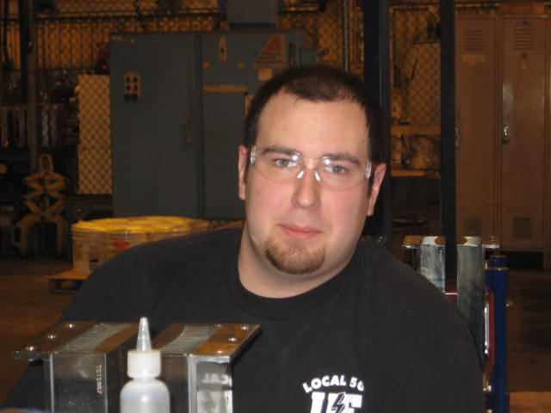
“UE is a special union because our members run our union and every member has a voice. As members we are encouraged , educated and empowered to fight for our rights, organize and negotiate for fair and improved working conditions. UE has become my family and given me a never-ending sense of support, solidarity and brother and sisterhood.” – Autumn Martinez, UE Local 255 member at Hunger Mountain Food Co-op, Montpelier, Vermont
“The heart of the UE is the membership. The blood that keeps that keeps that heart pumping is how engaged the membership is. The challenge we all face is, how do I play an active role in UE?” – Erik Gaston, UE Local 506, General Electric, Erie, Pennsylvania

Slide 3
What Is UE?
UE is a rank-and-file-controlled, independent national union, founded in 1936.
UE is made up of more than 100 local unions in 20 states.
The members decide the union’s goals and strategies, approve contracts and policies.
The members even determine the pay of the union officers and staff, which by UE Constitution can’t be more than the highest-paid working members.

Slide 4
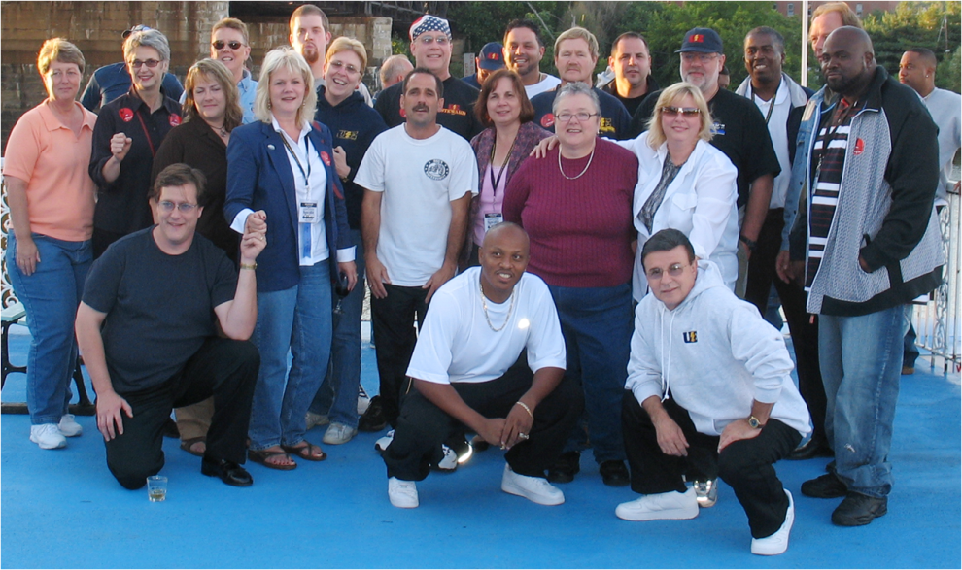
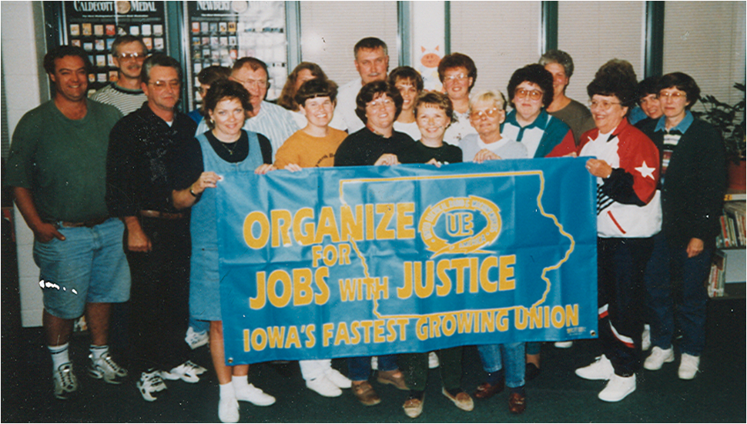
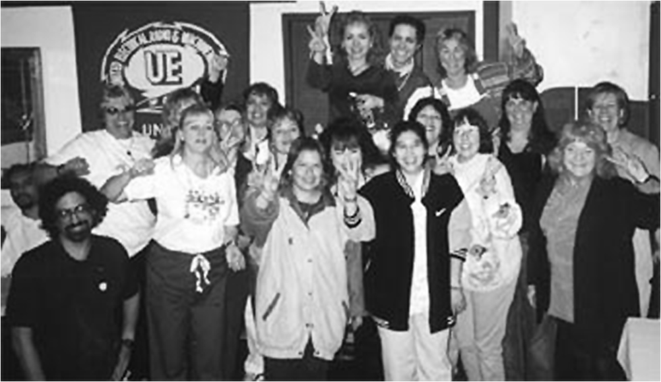
UE members do many kinds of work in both the private and public sectors
Notes:
We build electrical equipment and machines, and we run machines to make auto parts, locks, plastic products and many other goods. We are also social workers, healthcare technicians, clerical workers and educational paraprofessionals. We process, distribute and market food, and serve lunch to school children. UE members repair roads, transport railroad workers, and build locomotives.

Slide 5
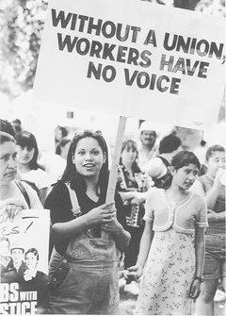
Notes:
The labor movement is the only consistent counterweight to corporate power in society. Unions are how we bring democracy to the workplace – how we balance the interests of the workers and the employer.

Slide 6
and a
27% MORE
Notes:
In 2012, the average union worker in the U.S. earned about 27% more than the average nonunion worker. That’s a difference of about $5 an hour. Not only do union workers earn more; they also have better benefits, better working conditions, protection against unfair discipline and a contract to make management keep its promises.

Slide 7
Notes:
Unlike non-union workers, who are “at will” and can be fired for any reason, or no reason, union workers can only be disciplined for “just cause.” Union workers also belong to organizations that can challenge disciplinary actions through the grievance procedure.

Slide 8
Notes:
The declining rate of union membership over the past 50 years has meant that the top 10 percent is getting a bigger share of our society’s wealth while workers get stagnant or declining wages and benefits.

Slide 9
RANK-AND-FILE UNIONISM
VS
BUSINESS UNIONISM
Notes:
Within the labor movement today, there are two models on the opposite ends of the labor spectrum: rank-and-file unionism and business unionism. Rank-and-file unionism is member run and member controlled unionism from the bottom up, like UE. Business unionism is top-down unionism where all the control is in the hands of the staff or national union, and where the members view the union as a vending machine: they pay their dues and if they need something, the “union” provides a service.

Slide 10
UE RANK-AND-FILE UNIONISM
Notes:
UE democratic, rank-and-file unionism, which is based on educating and empowering our members to fight to defend and advance their interests, has been integral in UE’s organizational structure from our union’s founding.

Slide 11
PREAMBLE TO UE CONSTITUTION
“WE form an organization which unites all workers on an industrial basis, and rank-and-file control, regardless of craft, age, sex, nationality, race, creed or political beliefs, and pursue at all times a policy of aggressive struggle to improve our conditions.”
Notes:
The guiding principles of the men and women who founded our union were summed up in the preamble to the UE Constitution, which remains a model of trade union democracy to this day. “We form an organization which unites all workers on an industrial basis, regardless of craft, age, sex, nationality, race, creed, or political beliefs…” They had learned the lessons of maintaining unity against the bosses’ attempts to divide and conquer. The preamble also expresses another lesson: “We form an organization to pursue at all times a policy of aggressive struggle to improve our conditions…” In the long struggle of workers in the U.S., there had been few gains without “aggressive struggle.” If there was a secret to the success of UE, it was that aggressive struggle creates strong, rank-and-file locals. And, strong, rank-and-file locals are the bedrock of union democracy. Again, in the words of the preamble: “We form an organization (under) rank-and-file control.” For a union that grew out of hundreds of local struggles, rank-and-file control would never be mere words. Indeed, it runs through the entire UE Constitution with a single, consistent, undeviating logic.

Slide 12
Article 25, UE Constitution, Rank-and-File Principles
Notes:
Rank and file control is established in each organizational unit in the UE structure by the membership and leadership of that unit – locals, region, and national. This democratic structure is welded into a strong national union by the fact that, while practicing autonomy, all bodies of the union are united by the union’s national constitution, and the policies and program adopted by rank-and-file delegates to the national convention. It has always been UE policy that each level in the structure operate without interference by others. It has also been policy that each level accepts and respects the role of the others – local, region and national.

Slide 13
OFFICER AND STAFF PAY
UE officers and staff are paid no more than the highest-paid workers in the union
Notes:
Another important UE Difference which distinguishes UE from most other unions today, is that our officers and staff are paid no more that the highest-paid workers in our union. The reason our union’s founders put this in our constitution was to ensure that our officers and staff lived like our members, and not like the bosses. In far too many unions today, their national officers earn six figures and have lavish perks.

Slide 14
PROUD TO BE INDEPENDENT
Notes:
Although we work with other unions on many levels – from strike and solidarity actions on the local level to Jobs with Justice nationwide – UE remains organizationally and philosophically independent from both the AFL-CIO and Change to Win.

Slide 15
DIFFERENCES BETWEEN RANK-AND-FILE UNIONISM AND BUSINESS UNIONISM
Notes:
For more than 75 years, UE has been a living example that democratic, rank-and-file unionism makes a difference in defending and improving the living standards of our members. What are the differences between UE rank-and-file unionism and business unionism?

Slide 16
 | RANK-AND-FILE UNIONISM | BUSINESS UNIONISM
DEMOCRATIC PROCEDURES | Regular Membership Meetings. Frequent election of local and national officers; ability to recall both. Members vote on contract proposals, settlements, arbitration, strikes, dues, legislative and political action programs, and all issues affecting their UE Local. | Staff or National Union make decisions on local contracts, grievances, strikes. Infrequent union elections.
Notes:
Facilitator notes: Depending on how much time you have, you can have the participants choose what topics that want to cover. You should also raise the question throughout these topics, how UE’s three core ideals of rank-and-file control, unity and aggressive struggle, come into play in ensuring rank-and-file unionism.

Slide 17
 | RANK-AND-FILE UNIONISM | BUSINESS UNIONISM
CONTRACT NEGOTIATIONS | Negotiating Committee Elected. Members Vote on Contract Proposals and Contract Settlement. Open Negotiations – Members Kept Fully Informed – No Gag Rule. Membership Mobilization to defend working conditions, contract and community. | Staff or National Union make decisions on local contracts and strikes. Members kept in the dark.

Slide 18
 | RANK-AND-FILE UNIONISM | BUSINESS UNIONISM
AGGRESSIVE STRUGGLE | An educated and empowered membership. Members decide when and how to take on a fight. A strong, well organized steward system is essential. Stewards are elected by the members in the area they will represent. | Officers believe that they must cooperate with employers to get anything for members. Few, if any, shop stewards.

Slide 19
 | RANK-AND-FILE UNIONISM | BUSINESS UNIONISM
FINANCIAL INTEGRITY | Members always have access to local and national financial records. Members vote to approve local expenditures. Regular trustee audits of books and records. No financial rewards for being union officer. | Finances kept secret from members. Officers and staff receive pay much higher than members’ wages, plus fat expense accounts.

Slide 20
 | RANK-AND-FILE UNIONISM | BUSINESS UNIONISM
POLITICAL ACTION | UE is not beholden to either major political party. UE doesn’t have a political action fund and doesn’t make donations to politicians. Locals decide for themselves who to support. UE mobilizes members around issues. | National Union tells members who to support. More emphasis on raising and donating money to politicians than on educating and mobilizing the members around issues.

Slide 21
 | RANK-AND-FILE UNIONISM | BUSINESS UNIONISM
ROLE OF STAFF | UE staff is employed by the membership through the national officers and GEB. UE staff implements the leadership’s decisions to build the membership and assist the locals and regions. UE staff has no right to interfere with UE rank-and-file control, including election processes at any level of the union. | Staff attempts to, or actually runs the union. See democracy as a hindrance to getting things done.

Slide 22
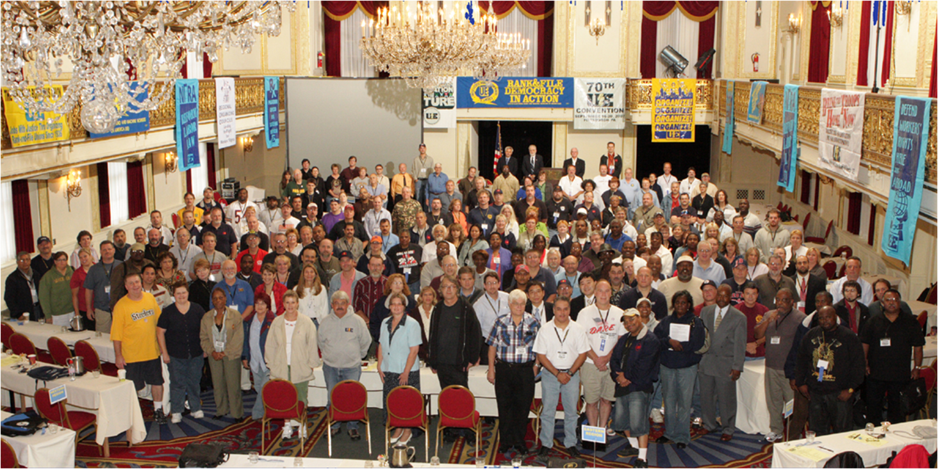
UE – Yesterday and Today
Notes:
In March 1936. 43 workers from 12 independent local unions came together in the midst of a severe snowstorm in Buffalo, NY to form UE. Their goal was to set up a national union to organize the hundreds of thousands of workers in the electrical, and then, machine tool industries in a way that hadn’t succeeded before. Instead of organizing only skilled workers, these workers wanted to organize everyone. The men and women who undertook this gigantic task were inspired by the need to build an industrial organization – meaning all workers could be part of the union – controlled by the members with complete equality for all who worked in that industry. They were determined to avoid the bureaucratic, top-down control that was characteristic of the existing craft unions where only skilled workers, usually white males, could belong. Today, elected rank-and-file delegates to UE Conventions carry on the work that the founders of our union started nearly eighty years ago.

Slide 23
EQUALITY AND SOLIDARITY
Notes:
Built on working class solidarity, UE set about overcoming old divisions in society. Every UE convention from the first took up the issues of equal rights for minority and women workers and discrimination in society. Here we see UE members from Schnectady, NY picketing GE to win fair wage rates for women workers. In 1942, UE began a pioneering fight against the practice of segregating women workers in low-paying jobs. GE and Westinghouse had established so-called “women’s jobs” in which women were paid less than men in comparable jobs in the plant. After a three year fight, UE was able to end that practice.

Slide 24
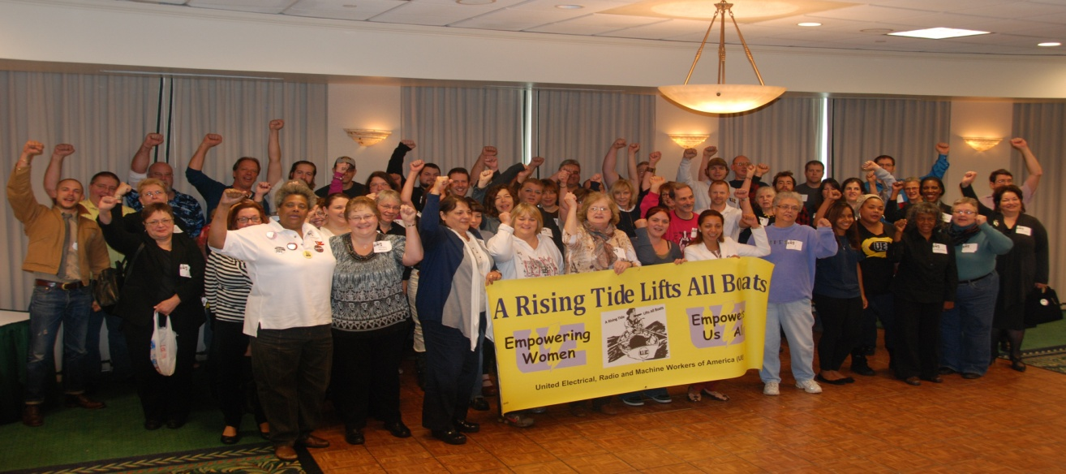
UE WOMEN’S CONFERENCES
Notes:
Early in its history, UE established special conferences for working women to develop and further the fight for “equal pay for equal work.”

Slide 25
UE FIGHTS RACISM AND DISCRIMINATION
Notes:
UE President Albert Fitzgerald confers with Ernest Thompson, Secretary of the UE Fair Practices Committee, at a UE Women's Conference in 1954. Starting in 1946, UE conducted an aggressive campaign nationally and in the shops we represent to eliminate racism and job discrimination against African American workers, as well as against other minorities and women, long before the rise of the modern Civil Rights Movement. Thompson, an outstanding UE international rep., coordinated those efforts. In that role he traveled throughout the union, met with locals, talked to officers and members, assessed their shops' record on black equality, and put together action plans for locals to fight for more black hiring and black promotion into skilled trades. Many locals took extraordinary steps to carry out this policy. UE took on major companies like GE, Sylvania and Westinghouse and publicly embarrassed them over their hypocrisy on racial issues. Thompson also directed the UE's women's rights work, which included national and district women's conferences, but much more. UE also led the way in fighting for "no discrimination" contract clauses.

Slide 26
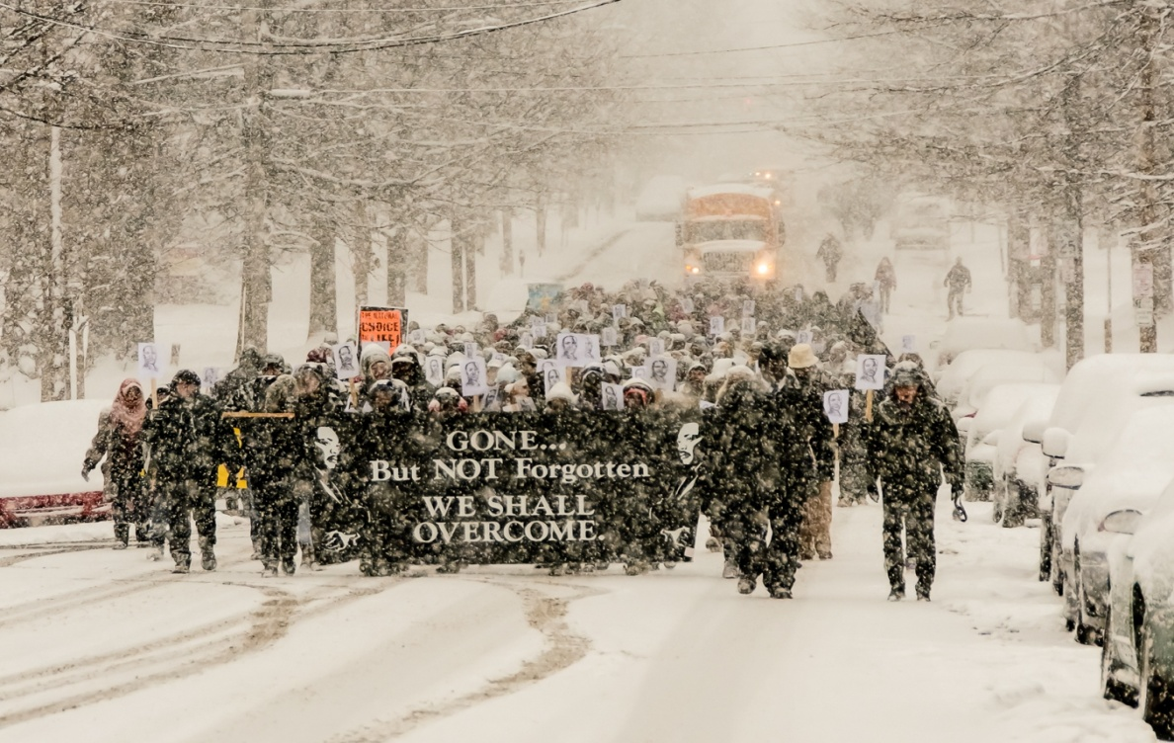
UE MARCHES FOR CIVIL RIGHTS
Notes:
UE members marched with Dr. Martin Luther King, Jr. in Washington, D.C. and heard his famous “I Have a Dream” speech. UE members are still carrying on the fight for civil rights today.

Slide 27
UE LEADS FIGHT AGAINST CONCESSION BARGAINING
Notes:
During the 1980s, when other unions were giving huge concessions to their employers, UE led the fight against concessionary bargaining, including this strike by thousands of UE Local 610 members at the Westinghouse Airbrake plant in Wilmerding, PA.

Slide 28
INTERNATIONAL SOLIDARITY
Notes:
But it isn't just UE's proud history we can point to when we think about what difference the UE difference makes. UE continues to be at the forefront of many important struggles. When other unions had fallen into the bosses’ trap of attacking low-wage workers in other countries, UE recognized that low wages exist not because people like living in poverty, but because large corporations and repressive governments make money by forcing people to work for poverty-level wages. In 1992, UE forged a Strategic Organizing Alliance with the Authentic Workers Front (F.A.T.), a democratic, independent Mexican union federation, to try and organize the sister shops of UE employers. Today, UE is playing a leading role in the Tri-National Solidarity Alliance, which unites unions and workers’ rights organizations in the U.S., Mexico and Canada.

Slide 29
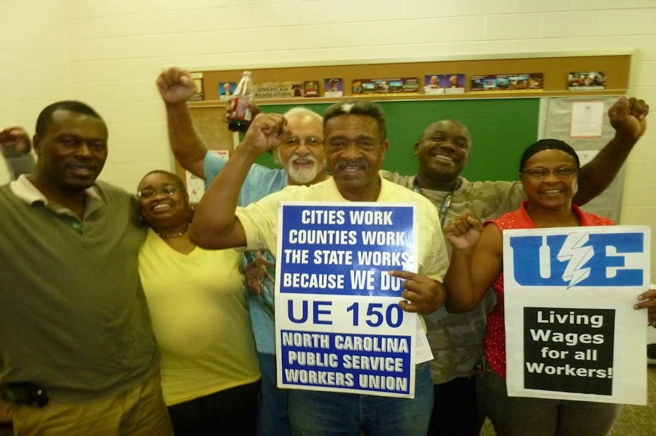
FIGHTING FOR COLLECTIVE BARGAINING RIGHTS
Notes:
While other unions have given up trying to organize public workers in Southern states without collective bargaining rights, UE is leading the fight for workers’ rights in North Carolina, Virginia and West Virginia. UE developed the ground-breaking Southern Workers International Justice Campaign, which is spearheading the fight for collective bargaining rights for public workers in the South.

Slide 30
FIGHTING PLANT CLOSINGS
Notes:
When Republic Windows and Doors tried to shut down its plant and throw the workers out in the street without any notice in2010, UE members occupied the plant for six days, defying the law. With the support of UE and its members and supporters across the country and around the world, the UE members at Republic were victorious in winning what they were owed. Today, the former Republic workers are in the process of turning their plant into a worker-owned co-operative, New Era Windows, with the support of UE.

Slide 31
NEW MODELS OF WORKER ORGANIZATION
Notes:
UE is playing a leading role in the labor movement in developing new ways of organizing workers out side the NLRB process. Founded in 2009, the UE-initiated Warehouse Workers for Justice (WWJ) challenges discrimination and other legal violations by major employers, educates workers on their rights, builds alliances in the community and with logistics workers in other cities, and fights to win policy changes that improve conditions for warehouse workers and their communities.

Slide 32
HOW CAN I BECOME ACTIVE?
Go to ueunion.org and learn more about your union.
Sign up for the UE Activist Net at ueunion.org.
Volunteer to assist your union officers or shop steward.
Volunteer for union committees, or start a committee.
Attend steward classes to learn how to defend members’ rights.
Participate in other union training put on by your local or UE Region.
Become a union steward.
Get involved in contract support work during negotiations.
Volunteer to help with UE organizing.
Join the UE Young Activist Program.
Notes:
Democratic, rank-and-file unionism requires membership involvement. These are some ways you can become active in our union.

Slide 33
UE RANK-AND-FILE UNIONISM: AN IDEA WORTH FIGHTING FOR
Notes:
Democracy is not easy. Rights must be vigorously defended; taking responsibility is also part of the package. But if democracy is difficult, it is also the only option that pays off in a stronger union, a better contract – and the satisfaction that comes with knowing that “we did it ourselves.” That’s what UE rank-and-file unionism is all about. It’s a goal worth achieving, an idea worth fighting to preserve.
Facilitator questions: Are there any UE members here who belonged to other unions? If so, what are some differences between the other union and UE?

