Slide 1
UE
POLITICAL ACTION
PRESENTS
WHAT IS THE TRANS-PACIFIC PARTNERSHIP (TPP)?

Slide 2
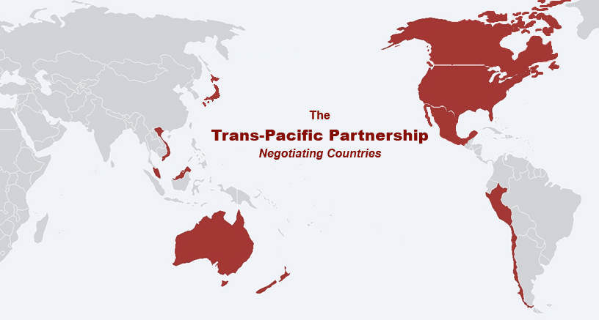
THE TRANS-PACIFIC PARTNERSHIP
Australia, Brunei, Canada, Chile, Japan, Malaysia, Mexico, New Zealand, Peru, Singapore, US, Vietnam
Notes:
The 11 countries of the pacific rim that are listed here are the original “negotiating countries”. However, THE TPP IS A “DOCKING” AGREEMENT OPEN TO ANY COUNRTY THAT AGREES TO ITS TERMS without the need to have all the original 11 agree to their entrance. So for example, China could join.
2

Slide 3
TPP IS AN ATTACK ON DEMOCRACY
Each signatory government must conform its domestic policies to the terms of the Trans-Pacific Partnership. Thus, the TPP would impose permanent restrictions on domestic federal and state policymaking.
“We are writing the constitution for a single global economy."
-Renato Ruggerio, first Director General of WTO
Notes:
Negotiated over five years by corporate representatives, the TPP is not a trade deal, but a global treaty granting extreme rights to corporations. Under the TPP domestic laws and policies cannot contradict the terms of the TPP, if they do, any “investor” (the term investor is what the TPP calls corporations) can sue for damages from the US federal government, then state and local governments, meaning we pay through our taxes and budget cuts. And unlike domestic legislation, the Trans-Pacific Partnership would have no expiration date and if the Trans-Pacific Partnership is implemented, the rules can only be changed if all parties agree.

Slide 4
UNDERMINING DEMOCRACY:
TPP ensures corporate controlled tribunals settle disputes between corporations and governments.
TPP will affect many aspects of our lives like medicine, consumer protections, internet freedom, and more.
TPP will drive down conditions for workers.
TPP will contribute to climate change.
And now that fast track has passed there is no changing the TPP- it’s just Yes or No.
Notes:
There are many major problems with the TPP. First is the ability to bypass domestic courts to resolve disputes brought by corporations against government laws that hurt profit, resulting in more corporate control at the expense of democracy. It will also affect our lives as consumers, extending the patents on medicines and making life saving drugs less available to developing countries, it will radically restrict our ability to regulate food and products imported into our stores to protect us from toxic chemicals or spoiled food. The TPP does nothing to prevent exploitation of workers or protect the freedom to unionize, the TPP will increase carbon emissions due to more products shipped from far away and doesn’t include Multilateral Environmental Agreements. Now that fast track has passed there is no changing the 5,600 page document or accompaning side agreements- ITS DONE. Congress must now vote yes or no. But if the US votes no, there will be no more TPP.

Slide 5
INVESTOR-STATE DISPUTE
RESOLUTION: A threat to our sovereignty and control
Corporations will be able to sue governments before a corporate controlled Tribunal, demanding our tax dollars compensate for their loss of “expected future profits” from any labor, environmental, health, safety, land use, and zoning laws we have in place.
Corporations will be able to bypass domestic courts and take their case to the Tribunal to be decided by three corporate lawyers who rotate between representing the corporations before the Tribunal and being the judges of the Tribunal.
Notes:
There is NO appealing the decision of the tribunal and there are no conflict of interest rules for the tribunal. The number of corporations and subsidiaries eligible to use this process is over 9,200. This could bankrupt governments. We know that over $365 million in public funds were paid in claims under NAFTA alone. And there remain $13 billion in pending corporate claims. Compared to NAFTA, the number of eligible corporations that can sue us is doubled. That means more lawsuits and more public funds going to corporations.
5

Slide 6
MOST OF THE TPP IS NOT ABOUT TRADE
NON-TRADE CHAPTERS
Government Procurement
Investment
Services
Financial Services
Telecommunications
E-commerce
Intellectual Property
Visas/Temporary Movement of Natural Persons
Regulatory Coherence
Sanitary Standards (food standards, animal disease, invasive species)
Technical Barriers (product safety standards, toxics, labeling)
Competition Policy
State Owned Enterprises
Supply Chains
Labor
Environment
Medicines
TRADE CHAPTERS
Market Access for Goods
Customs
Trade Facilitation and Capacity
Building
Trade Remedies (Anti-dumping/CVD)
Subsidies
ADMINISTRATIVE CHAPTERS
Initial Provisions
Exceptions
Dispute Settlement
Final Provisions
Notes:
This shows 17 non-trade chapters in the 5,600 page TPP agreement compared to the 5 trade chapters and four administrative chapters.

Slide 7
TPP’S NON-TRADE POLICIES
Foreign firms can effectively stop any financial regulation including restructuring of debt, bans on toxic derivatives or other dangerous financial practices.
Extends patents on drugs, limits fair use of copyrighted material, bans tinkering with software and digital devices and criminalizes disclosures of trade information.
Places similar limits on our Internet freedom that Congress rejected in 2011 with SOPA.
Greater property rights for foreign investors than domestic firms.
The national security defense exception is not an excuse for lost profit as it has been in other trade agreements.
Notes:
Some examples of the non-trade policies that, if approved, the US must conform to without our consent. The TPP says that our federal laws are under TPP governance right away, and state and local laws within a few years. We will lose a lot of control over our economy shortly. Any attempts to pass laws that contradict the TPP policies could cost us millions, quickly bankrupting local governments. Even language commonly found in other trade agreements that allows for exceptions to the trade restrictions “for the national defense” is not included in this agreement. (SOPA is Stop Online Piracy Act which restricts some basic uses of the internet.)

Slide 8
TPP’S NON-TRADE POLICIES
Continued….
U.S. must import food that does not meet U.S. standards, putting our health at risk and undermining U.S. producers.
“Buy American”, “Buy Local” procurement preferences forbidden, first federally then state and municipalities.
“Transparency” chapter would allow pharmaceutical firms to challenge drug-price decisions by Medicare, Medicaid, VA formularies.
State laws are subject to direct challenge in corporate tribunals by foreign investors.
Notes:
Restricts our ability to inspect and block the entry of food deemed unsanitary, prohibits bans on toxic ingredients found in food or consumer products, prevents us from requiring the government to purchase locally made products or food, for example, schools couldn’t require locally grown veggies for lunches, it allows for pharmaceutical firms to challenge drug-price decisions by Medicare, Medicaid, etc meaning we couldn’t negotiate lower prices. It also allows our state laws to be challenged in the corporate tribunal.

Slide 9
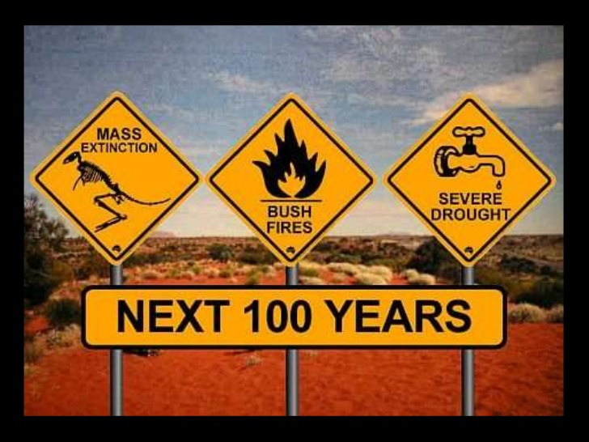
TPP CONTRIBUTES TO CLIMATE CHANGE
Will increase carbon emissions that are heating up our planet and provoking mass extinction of life;
Would increase fracking and natural gas export;
Weak language on conservation and gives fossil fuel corporations the right to challenge climate protections similar to the challenge of the Keystone pipeline decision by TransCanada;
Multilateral Environmental Agreements Rollback-unlike past trade agreements, the TPP does not obligate nations to follow all seven core MEAs;
Notes:
The entire 5,600 page TPP document doesn’t mention climate change even once. What it does is ensure we will be shipping more goods from farther away- increasing carbon emissions. It requires the US Dept. of Energy to approve all exports of liquified natural gas to TPP countries- bumping up production. It also allows for corporations to sue for lost profit if a state bans fracking among other challenges of climate protections via these unaccountable tribunals. An example of what we can expect happened recently when TransCanada, the company behind the Keystone XL pipeline, announced Wednesday it is filing a claim under the North American Free Trade Agreement (NAFTA), saying that the project’s permit denial was “arbitrary and unjustified.” TransCanada is seeking $15 billion in costs and damages due to the denial, and has also filed a separate lawsuit against the U.S. in federal court. There are seven core MEAs that protect our water, air, endangered species, against toxic chemicals and hazardous waste, and biodiversity. The only MEA mentioned is against international trade in endangered species. Even so, it is unlikely that violations to the one MEA would be challenged since the US has never once brought a trade case against another country for failure to live up to its environmental commitments in trade deals.

Slide 10
WHAT ABOUT LABOR STANDARDS?
The most recent US Department of Labor report shows that Malaysia uses forced labor in its electronics and garment industry, and child labor to produce palm oil.
Mass graves were recently discovered with 139 bodies of men, women and children showing signs of torture.
Notes:
You may have heard of the anger expressed that Malaysia was allowed to enter into the TPP with such a terrible human rights record. Read.
Vietnam is considered Tier 2 for trafficking- very bad, but not the worst. In addition, freedom to organize in Vietnam, Malaysia and Brunei is non-existent. The TPP includes side arrangements with Vietnam, Malaysia and Brunei which are weak, for example the TPP asks for the commitment to discourage trade in goods made with forced labor, but no prohibition.
In addition, there is no side agreement with Mexico which has extreme human rights abuses and a country rife with protection unions and contracts defended by the government. Even so, we know from our experience with NAFTA that enforcement of labor and human rights through side agreements is not possible.
For example, it includes a “commitment to discourage” trade in goods made with forced labor and does not prohibit the trade in such goods.

Slide 11
ENSURES A RAW DEAL FOR WORKERS
UNDER NAFTA:
Over 5 million U.S. manufacturing jobs gone;
45,000 U.S. manufacturing facilities gone;
Millions of service sector jobs off-shored;
Real median wages at 1972 levels;
Tax bases shrink: schools, infrastructure cut;
Floods of unsafe imported food, products;
Environmental, health, zoning laws attacked in foreign trade tribunals & dumped;
Displacement, migration, hunger in developing country trade partners;
Notes:
Under TPP there is a initial estimate by the Wall Street Journal of 330,000 jobs lost. We know this number will most likely be higher. We can predict the outcomes of the TPP by looking at past trade deals. Under NAFTA we saw …
11

Slide 12
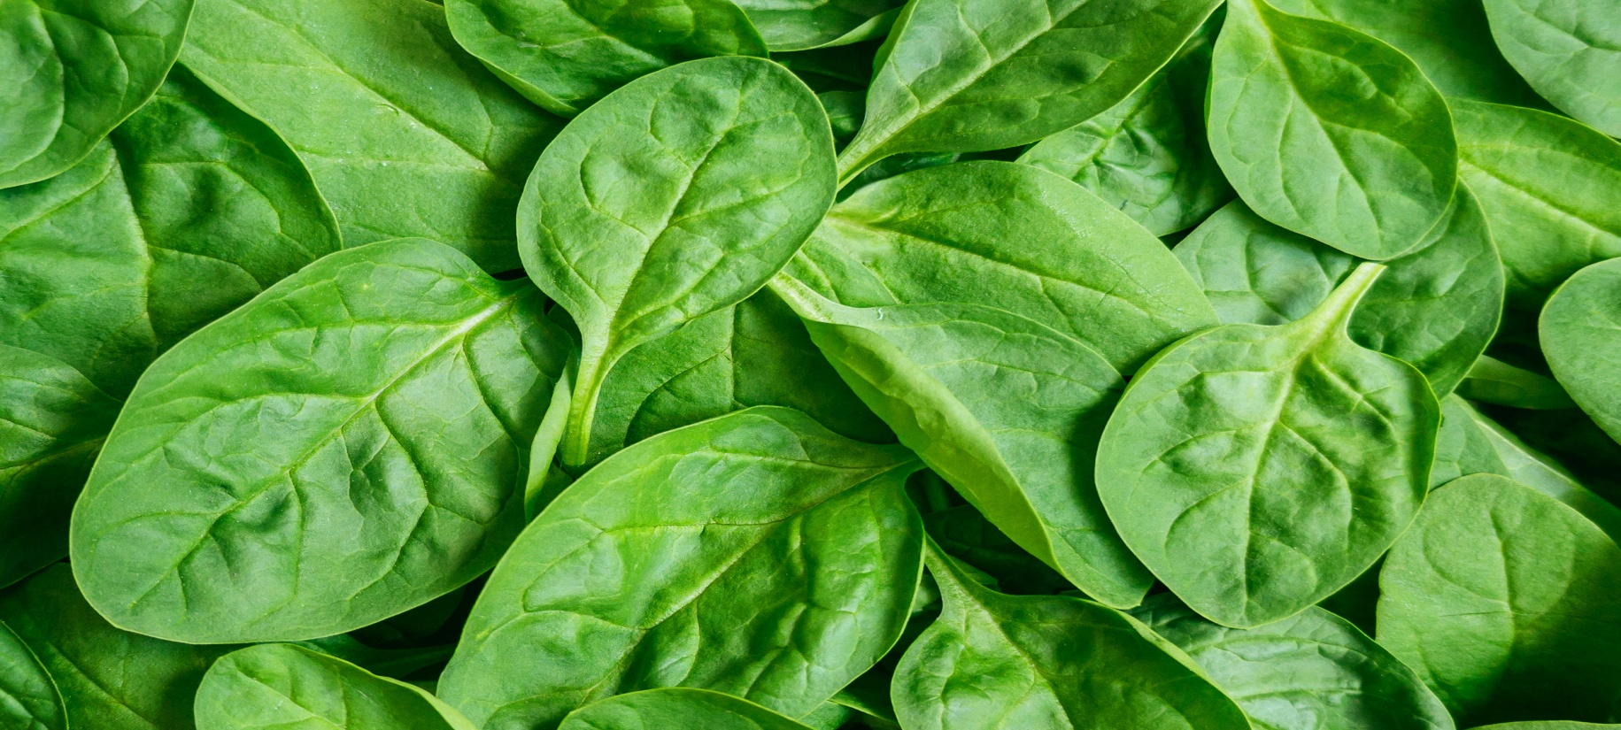
BYE - BYE, BUY LOCAL
TPP will hurt our ability to have government services procure products locally and will allow for products to be labeled as “Made in America” with only 45% of the components or ingredients actually made in the US.
Notes:
Eliminates local procurement which means we lose our ability to engage in stimulus spending when the economy needs it or make sure we can get locally grown food for schools and even if we try as consumers to favor locally made products, labeling will allow “Made in America” with 45% actually made in America. Recently the WTO forced us to stop labeling country of origin on our meat labels! We can expect more and more of this under TPP.

Slide 13
TPP PUTS WORKERS IN A RACE TO THE BOTTOM
Mexico $4.80/day ($124/month)
Vietnam $155/month
Malaysia $187/month
Chile $354/month
Peru $222/month
Japan $6.30/hr
Canada $7.69/hr
New Zealand $9.46
Australia $12.10/hr
Notes:
How low can we go? Here are the minimum wages in the 10 other countries involved in the TPP. Some countries use an hourly rate, while others use a monthly or daily minimum. Two countries do not have minimum wage laws at all.

Slide 14
“FAST-TRACK” ONLY NEEDED FOR BAD AGREEMENTS
Of 500+ trade agreements since 1974, Fast Track was only used for 16 of them.
Fast Track was used to force NAFTA, WTO, CAFTA, Korea, Colombia “free trade” agreements into place.
Candidate Obama said he would
“replace Fast Track … I will ensure that Congress plays a strong and informed role in our international economic policy and in any future agreements we pursue and in our efforts to amend existing agreements.”
But in June 2015 Congress granted his request for this extreme trade authority!

Slide 15
THE 99% MUST
FIGHT BACK AGAINST
THE TPP

Slide 16
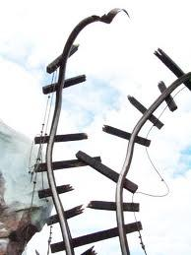
WE CAN WIN!
Battles Won Against Corporate Power-Grabs via “Trade” Agreements
STOPPED: Fast Track in 1998
DERAILED: WTO Expansion: Seattle ‘99 –today!
DERAILED: FTAA (Free Trade Area of the Americas)
DERAILED: MAI (Multilateral Agreement on Investment)
DERAILED: AFTA, Malaysia, SACU, Thailand, FTAs
Notes:
Its been done before, a pissed off populace has de-railed the following trade agreements.

Slide 17
GLOBAL RESISTANCE HAS BEGUN…

Slide 18
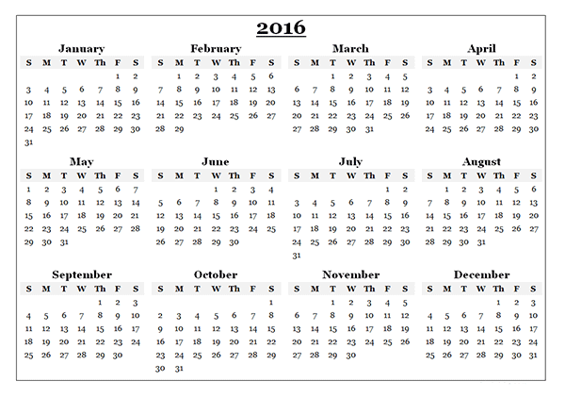
WE NEED TO ACT NOW
A YES or NO vote on TPP is expected in 2016
Many predict the vote will take place in February or during the “Lame Duck” session of Congress post election.
Notes:
Add congressional timetable: As early as February 2016, lame duck session or possibly until there is a new president. Balance of forces who we hope continue to oppose TPP: Anti-Obama Republicans, tea party nationalists, Progressive Democrats- but we should expect there will be extreme pressure on the democrats reminiscent of the vote buying that took place to get NAFTA passed.

Slide 19
THE FOLLOWING DEMOCRATS IN UE BASE AREAS VOTED FOR FAST TRACK
Brad Ashford (NE-2) Omaha area
Ami Bera (CA-07) Sacramento County
Donald Beyer (VA-8) Northern Virginia
Gerry Connolly (VA-11) Northern Virginia
Jim Costa (CA-16) Fresno & Madera Counties
Susan Davis (CA-53) San Diego County
Sam Farr (CA-20) Monterey & San Benito Counties
Jim Himes (CT-4) Fairfield County
Ron Kind (WI-3) - Southwest Wisconsin
Mike Quigley (IL-5) Chicago
Scott Peters (CA-52) San Diego County
Visit Public Citizen’s website to follow Congressional news on the TPP.
To find out about actions against the TPP near you check out Flush the TPP! (flushthetpp.org)
Notes:
The following Democrats in areas with UE members voted in favor of fast track. These should be the targets to get to vote no on the TPP.
Media work must be done as well to change the narrative on what the TPP will do to us.

